Slide 1


Ascension of Atlas
Themes
Oshawott:
Haydon Derrick
Leon Stone
Matthew Hadley
Turn based
Open world
Strategy

Slide 2
Themes
OshaWhat?
About The Game
OshaWhat?
Turn based
Open world
Strategy
Oshawott
The game will be set in the near future to justify the use of some more advanced technology than is available currently
There will be a desert setting where the player will be introduced to the game and they can run around and get used to the different mechanics, eventually they will be able to discover a boss out in the desert that they have to defeat in order to beat the game
Oshawott:
Haydon derrick
Leon
Matthew Hadly
Notes:
Matt

Slide 3
Themes
Ideas :)
About The Game
The game will be set in the near future to justify the use of some more advanced technology than is available currently
There will be a desert setting where the player will be introduced to the game and they can run around and get used to the different mechanics, eventually they will be able to discover a boss out in the desert that they have to defeat in order to beat the game
Money can be obtained by killing enemies out in the world
Purchasable moves to upgrade the player can be purchased with said money
The desert will be a big open world area that is populated by different enemy types
The player will encounter a boss out in the desert which is the objective of the game to defeat
Turn based
Open world
Strategy
Notes:
Haydon

Slide 4
About The Game
Combat
Ideas :)
Purchasable moves to upgrade the player can be purchased with said money
The desert will be a big open world area that is populated by different enemy types
The player will encounter a boss out in the desert which is the objective of the game to defeat
Cities in the background will be billboards to improve performance
The game will be set in the near future to justify the use of some more advanced technology than is available currently
There will be a desert setting where the player will be introduced to the game and they can run around and get used to the different mechanics, eventually they will be able to discover a boss out in the desert that they have to defeat in order to beat the game
The game will have a close range melee attack and a ranged attack to choose between in combat
Killing enemies will provide the player with a fixed amount of reward that comes in the form of money
If you visit your home in the desert, you can upgrade yourself to get more abilities
Notes:
Hayydon

Slide 5
Ideas :)
Similar games/Inspirations for enviroment
Role Allocation
Combat
The game will have a close range melee attack and a ranged attack to choose between in combat
Killing enemies will provide the player with a fixed amount of reward that comes in the form of money
If you visit your home in the desert, you can upgrade yourself to get more abilities
Game world, character movement – Haydon
Enemies AI and models – Leon
Player combat system UI and code - Matt
Money can be obtained by killing enemies out in the world
Purchasable moves to upgrade the player can be purchased with said money
The desert will be a big open world area that is populated by different enemy types
The player will encounter a boss out in the desert which is the objective of the game to defeat
Notes:
Matt

Slide 6
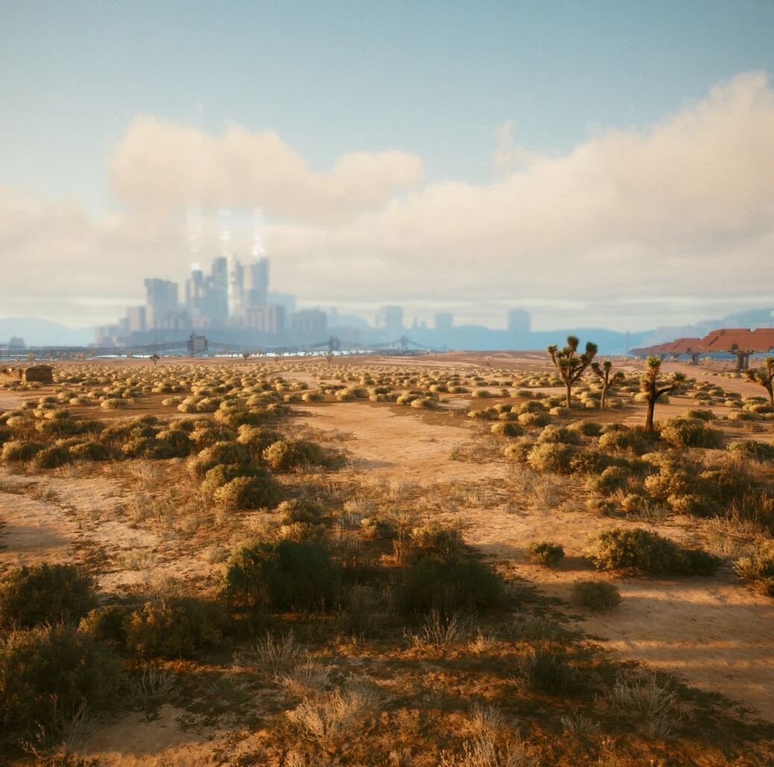
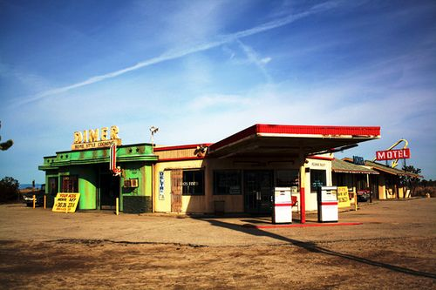
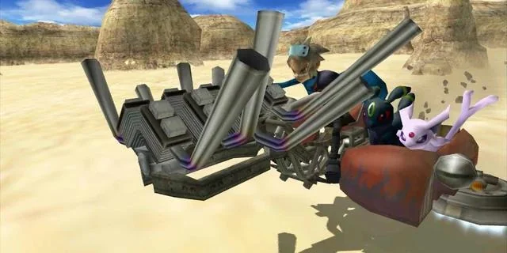
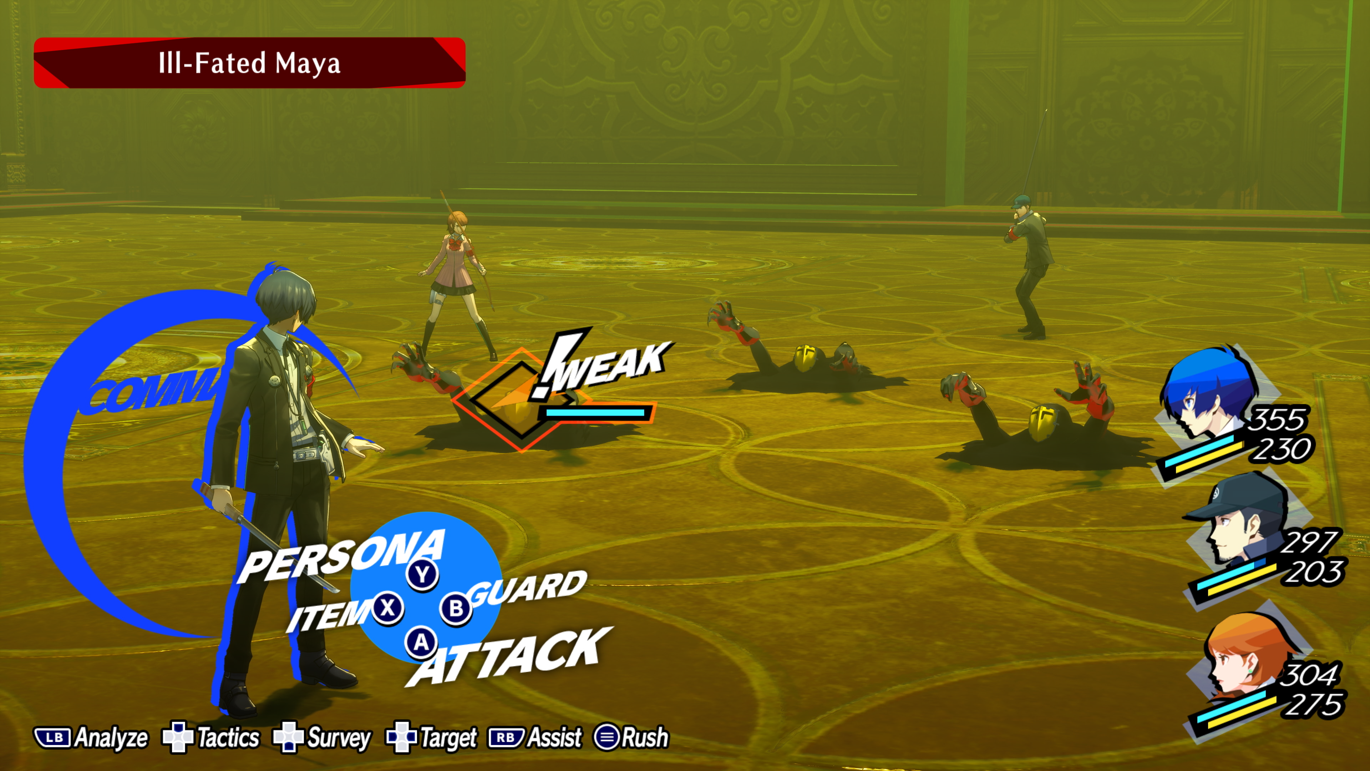
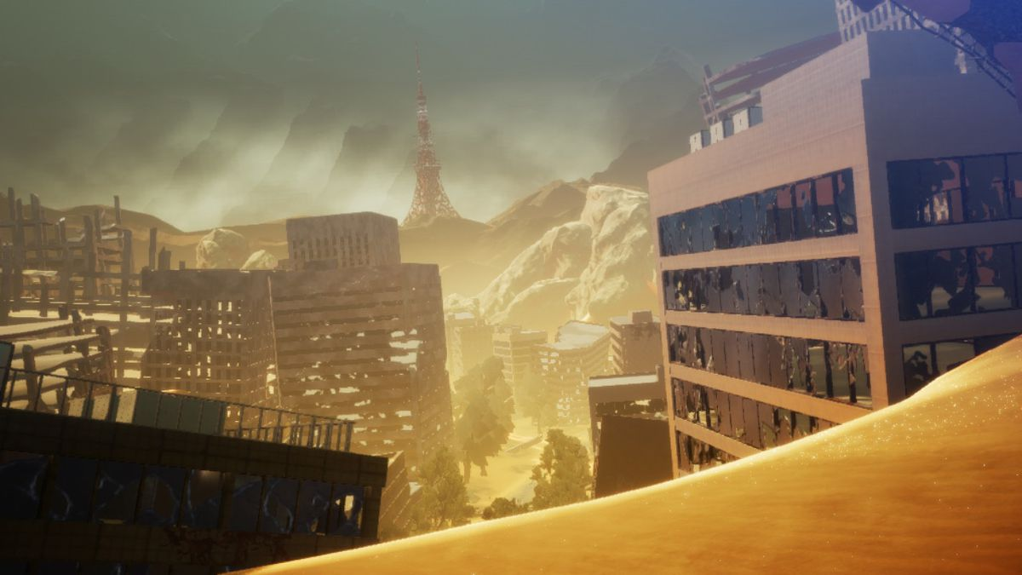
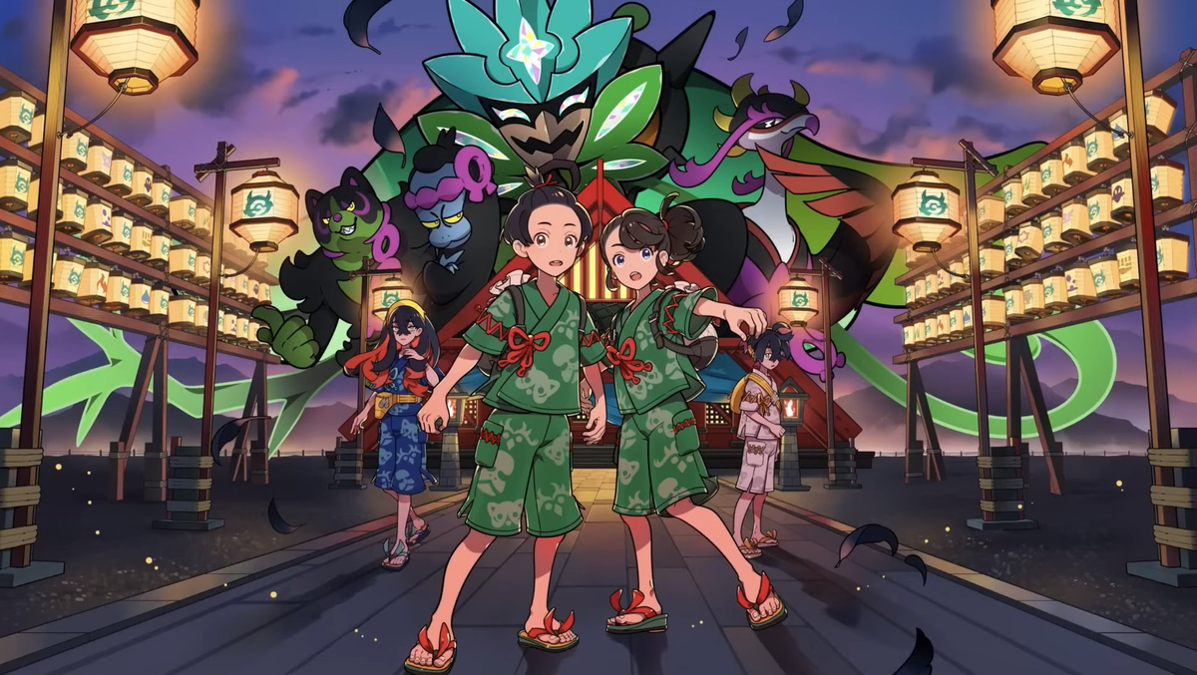
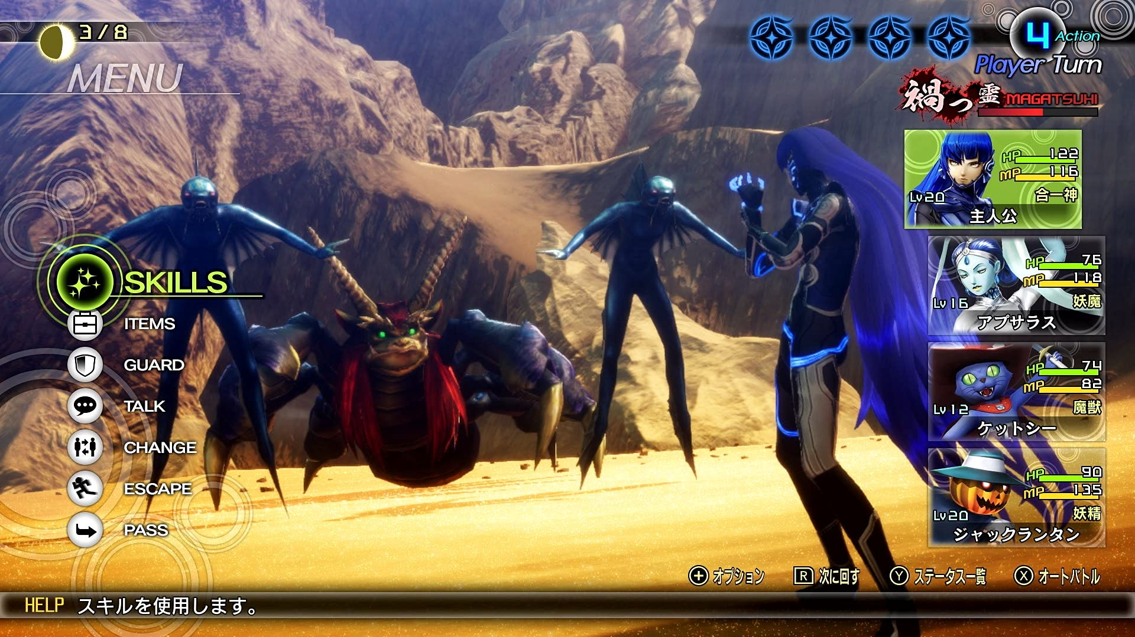
Character inspirations
Similar games/Inspirations for the
environment
Notes:
Leon
Cyberpunk
Shin Megami Tensei 5
Pokemon Scarlet/Violet & Pokemon Collusseum

Slide 7
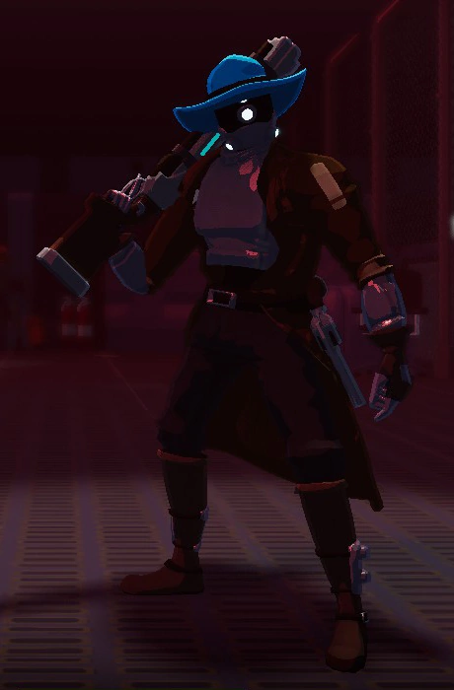
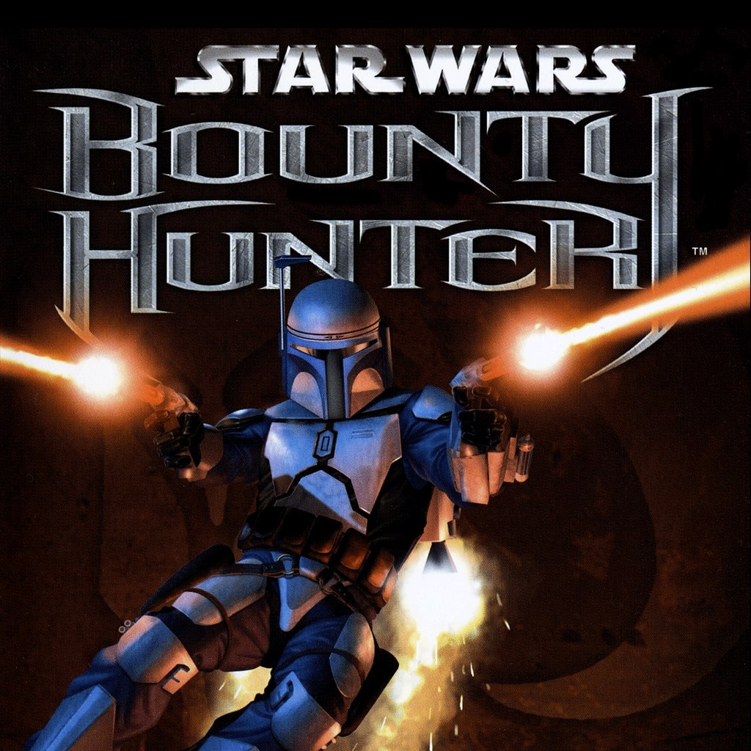
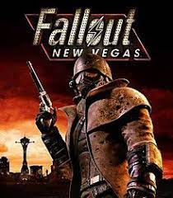
Role Allocation
Similar games/Inspirations for enviroment
Character Inspirations
Notes:
Leon
Risk of rain 2

Slide 8
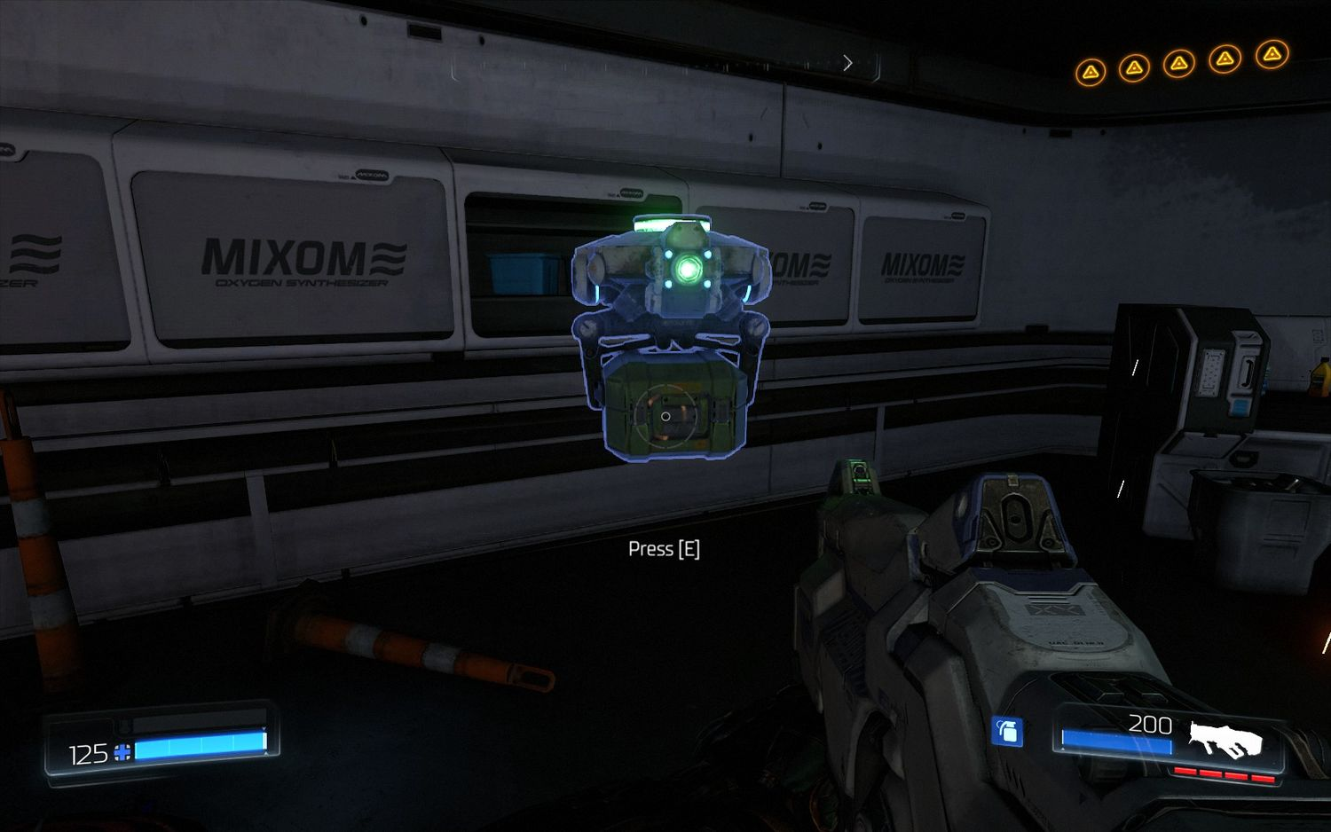
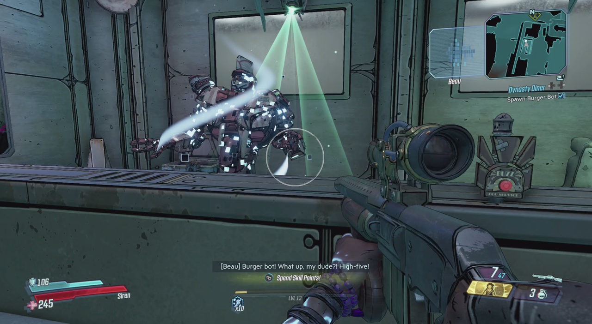
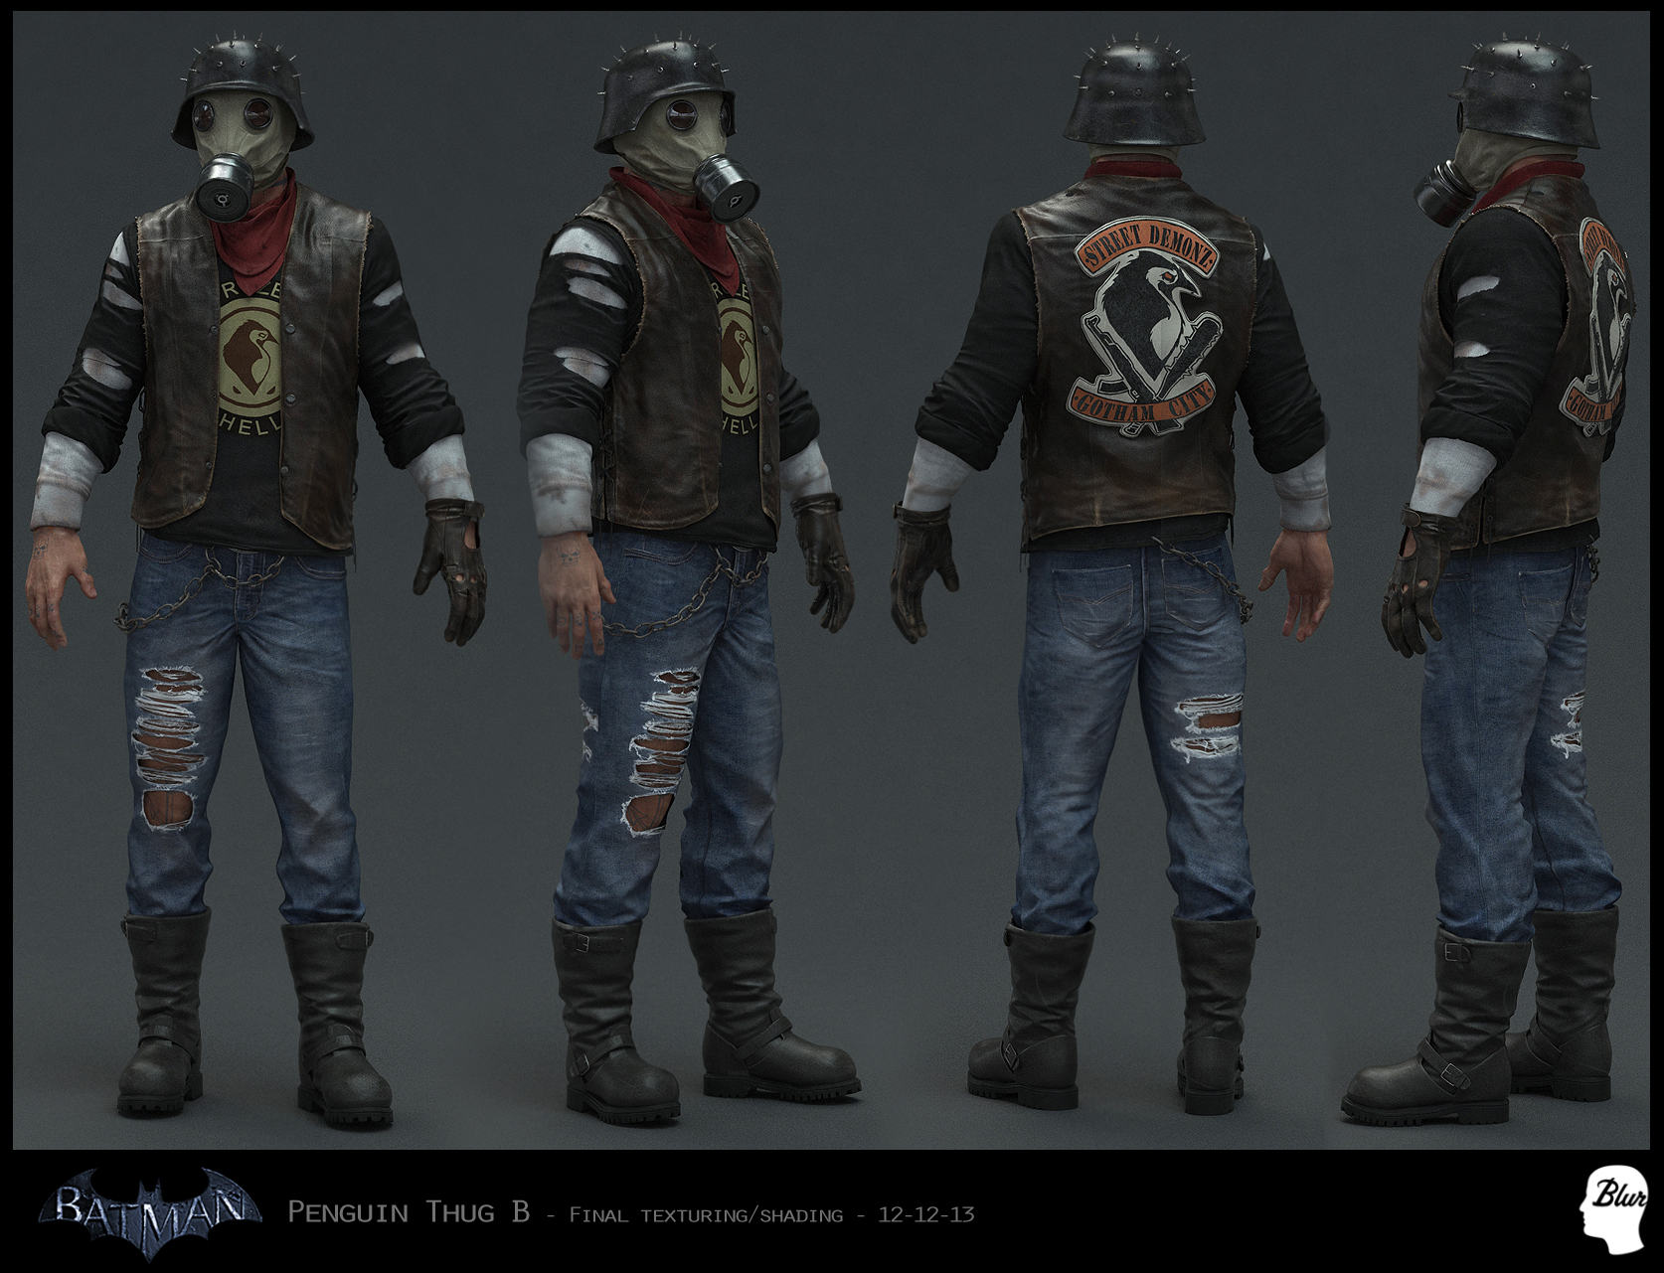
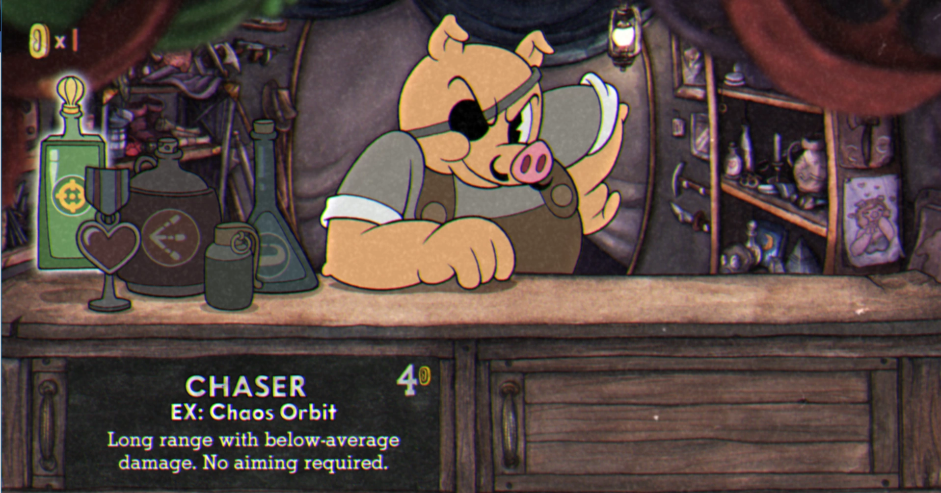
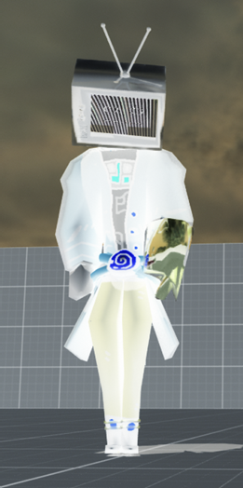


Other entities
Upgraderbot
thug bat
Thug gun
the reverse TV man
Notes:
Leon
Borderlands
Doom Batman Arkham
Cuphead
Thug stock images@gmail.com

Slide 9
Switch specific
To account for the lower power of the Nintendo switch, the games art style will use a cell shaded design and lower resolution in comparison to the PlayStation 4 and PC.
The game will be scalable to played in either handheld, docked and tabletop mode e.g text size will be adaptable along with UI.
The controller rumbles will be implemented, which will be used when dealing/taking damage.
Notes:
Haydon

Slide 10
Role Allocation
Game world, character movement – Haydon
Enemies AI and models – Leon
Player combat system UI and code - Matt
The game will have a close range melee attack and a ranged attack to choose between in combat
Killing enemies will provide the player with a fixed amount of reward that comes in the form of money
If you visit your home in the desert, you can upgrade yourself to get more abilities
Notes:
Matt

Slide 11
Potential Problems
To access combat segments, the player will overlap with an enemy bounding box to send them to a new scene where the combat will take place, however if this is taxing on the device it could lead to performance problems. To combat this an alternative solution would be to instead pan the camera out in the overworld to then switch to the combat scenario.
A saving system will need to be implemented using binary files, due to a lack of public documentation, this could be a really difficult thing to implement. A potential solution to this would be to use player preffs, as this is something that we have used in the past and would have a better idea of how to implement.
Notes:
Haydon

Slide 12
Stretch goals
Larger area of play to explore
More NPC variety
Secret boss
More unlockable skills
Notes:
Mat

Slide 13
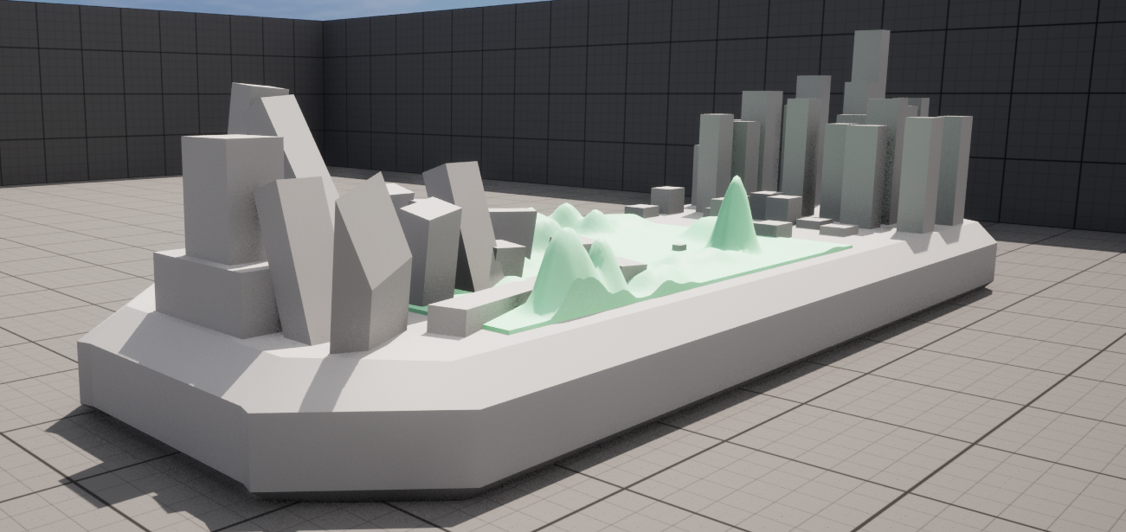
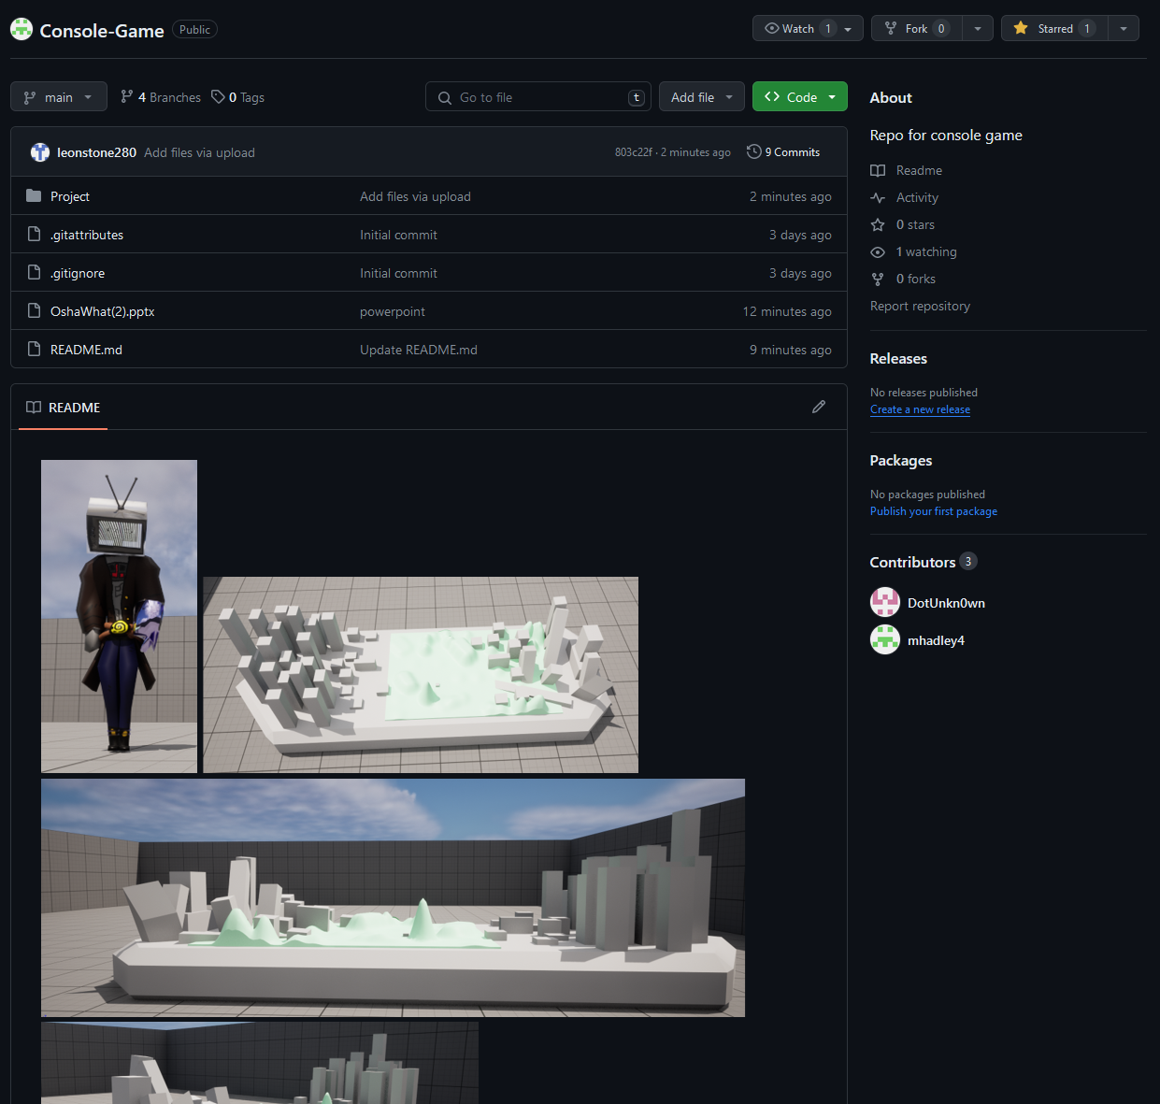
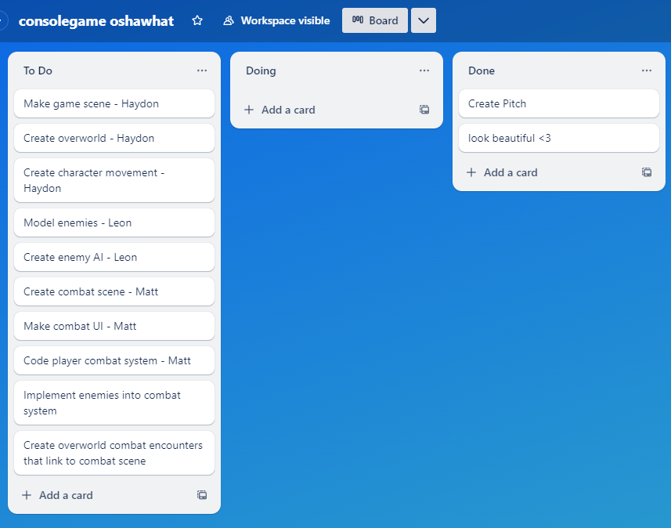
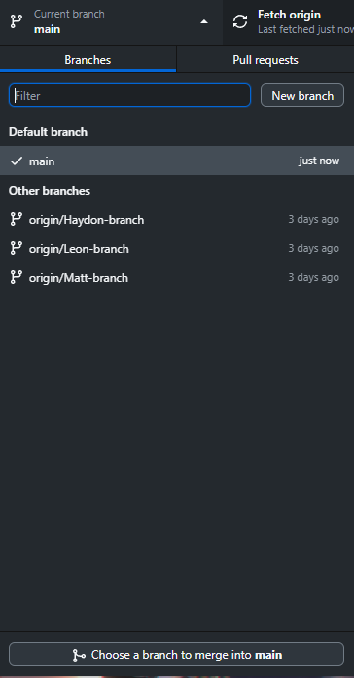
Kanban Methodology/Git Repo
Notes:
Haydon

Slide 14
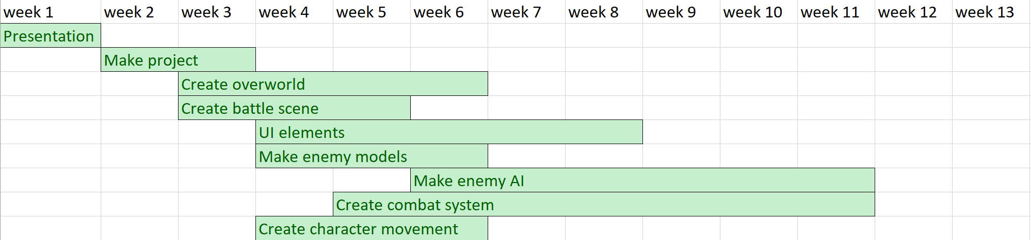
Timeline/Gyantt chart
Notes:
Haydon

Slide 15
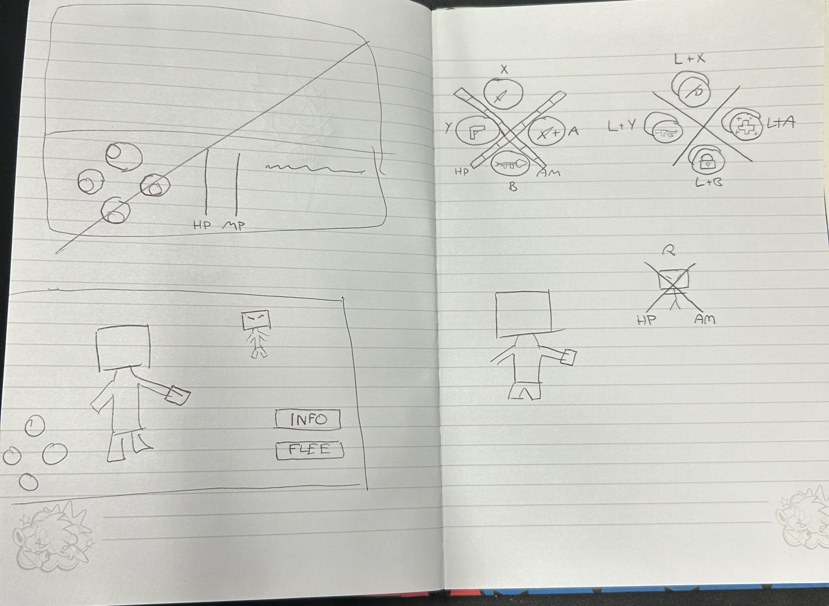
Concept art (combat)
Combat UI layout
Close-up of button UI
Notes:
Leohb

Slide 16
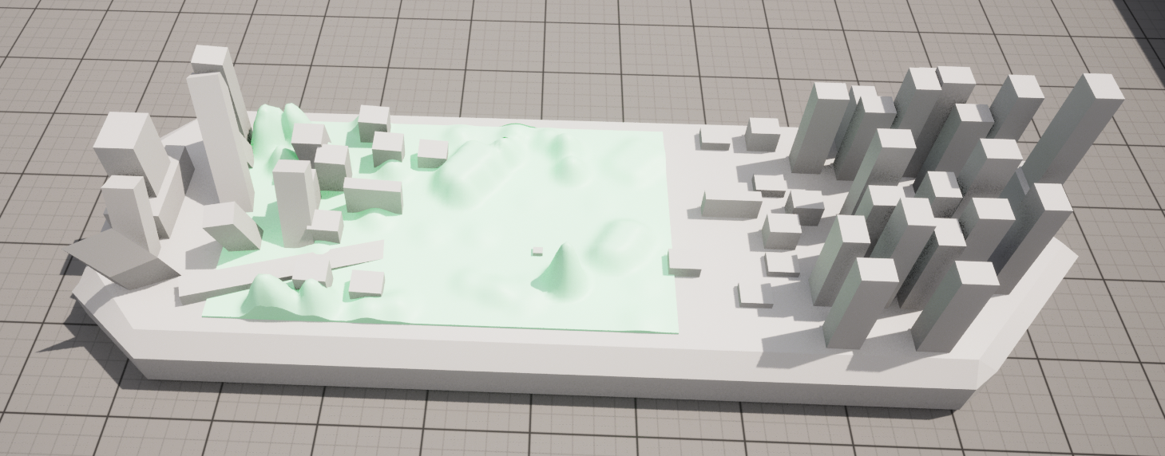
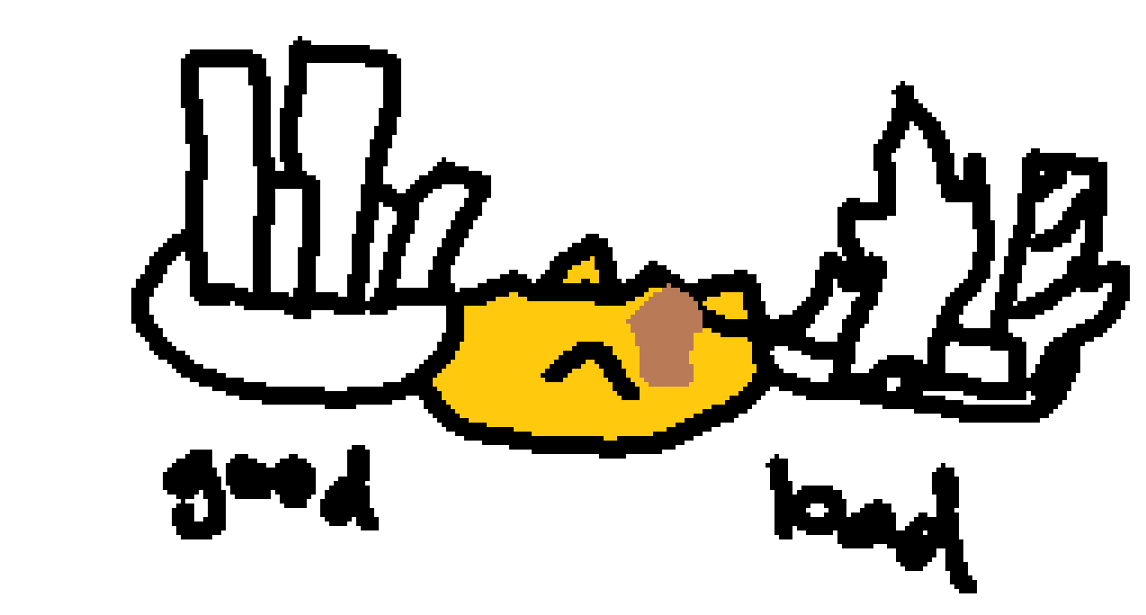
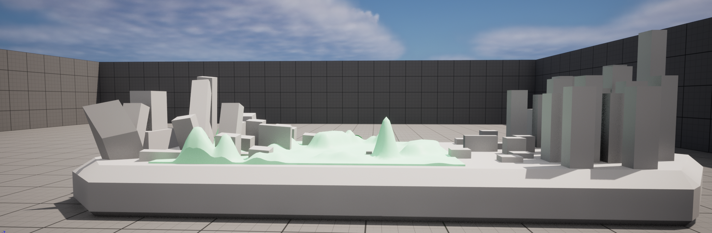
Concept art (world)
Notes:
<Mayyt

Slide 17
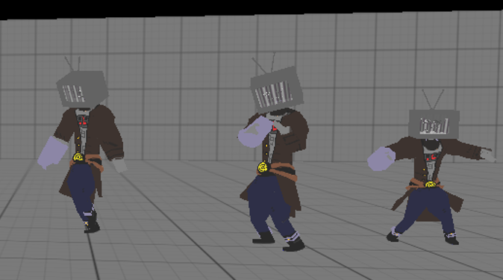
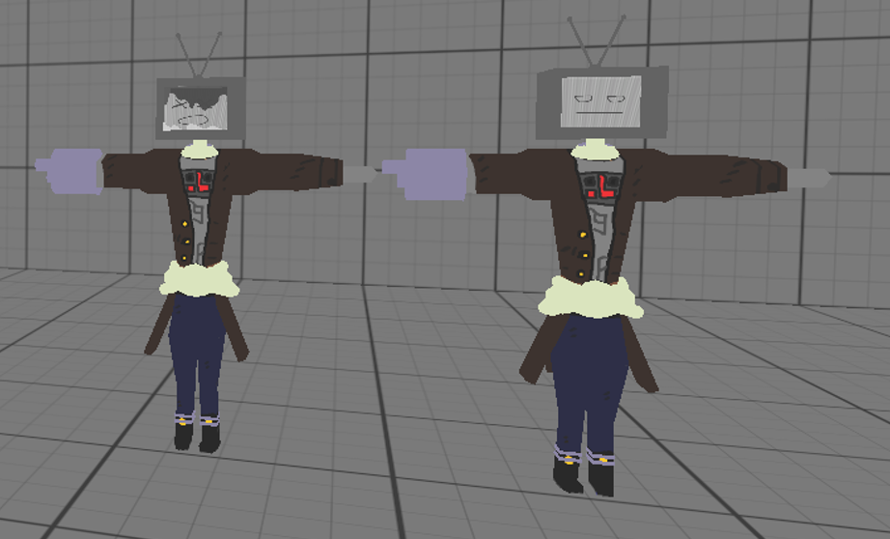


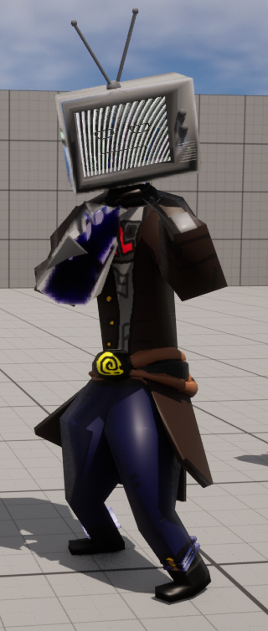
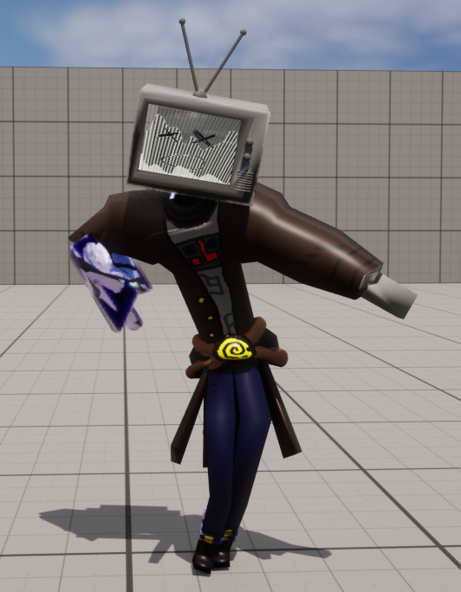
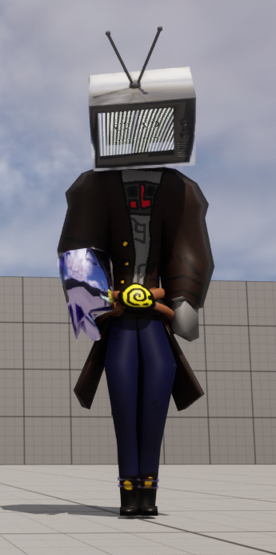
Character design
Notes:
Matt

